Slide 1


Functional Analysis
by @starline at freepik.com
The biology behind the genes
This course was inspired by the previous VIB Functional Analysis training and the SIB training session.
CC by 4.0

Slide 2
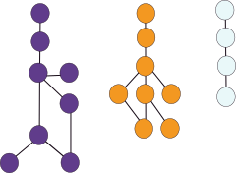
What is Functional analysis?

Slide 3
Biology behind genes
Looking into genes function:
Individually
Focus in one main gene
Out of context
Individual analysis
Context
by @starline at freepik.com

Slide 4



Biology behind genes
SEMANTICS
Looking into genes function:
Individually
Focus in one main gene
Out of context
Lists of genes
Looking into genes function:
Individually
Focus in one main gene
Out of context
Look
Look into
Look forward
Individual analysis
Context
by @starline at freepik.com

Slide 5
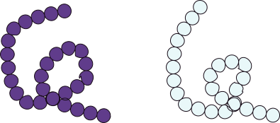
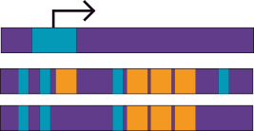
Biology behind genes
Looking into genes function:
Individually
Focus in one main gene
Out of context
Lists of genes
Prioritize context
Understand biological relationship
Common functions/structure
Network related
Common transcription factors
Similar motifs
by @starline at freepik.com

Slide 6
Biology behind genes
Looking into genes function:
Individually
Focus in one main gene
Out of context
Lists of genes
Prioritize context
Understand biological relationship
Context
Define what is their relation within the context = condition
by @starline at freepik.com

Slide 7
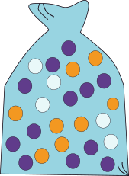
Biology behind genes
Overrepresentation analysis
Different methods:
Enrichment analysis
Gene Ontology (GO)
Gene-set (GSEA)
Topology
Pathway
Gene Expression
Differential Expression
Annotation
Gene
Protein
by @starline at freepik.com

Slide 8
Quality and context
Data introduction

Slide 9
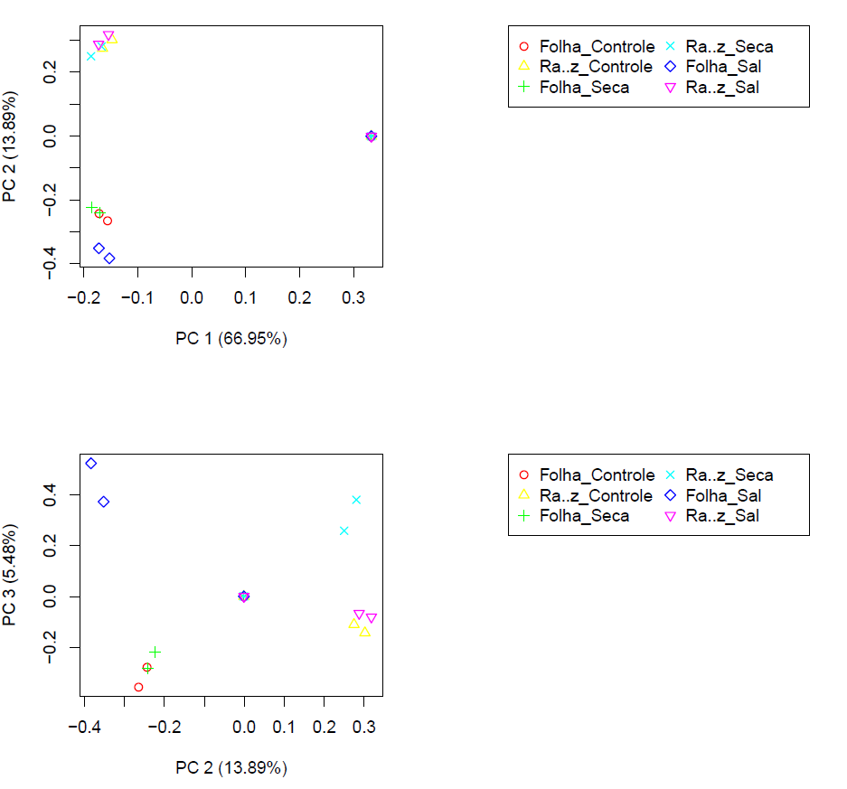

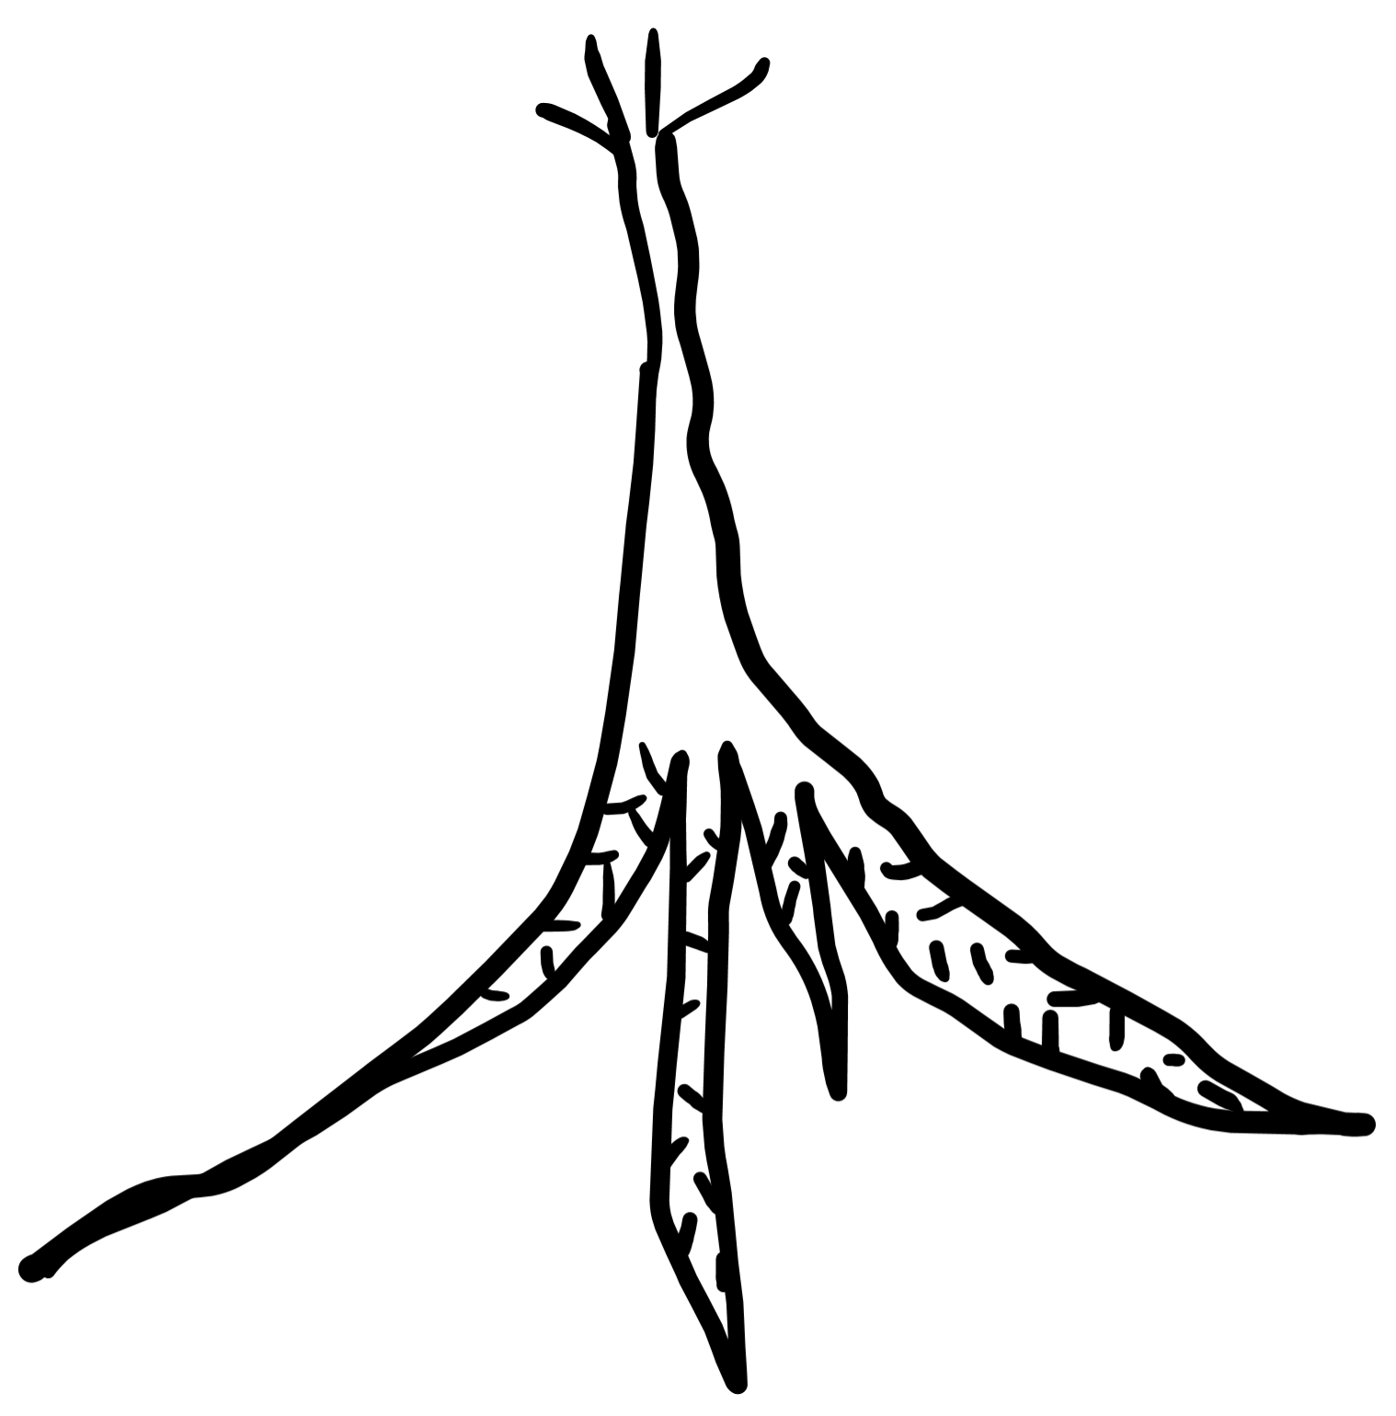
Quality control
Hints of the context
The assembling …
PCA: Correlation between samples
Metadata: Information about samples
etc…
Leaf_CT
Root_CT
Leaf_Drouth
Root_Drouth
Leaf_Salt
Root_Salt
https://www.ncbi.nlm.nih.gov/bioproject/?term=PRJNA282367

Slide 10
Quality control
Hints of the context
The assembling …
PCA: Correlation between samples
Metadata: Information about samples
etc…
Leaf_CT
Root_CT
Leaf_Drouth
Root_Drouth
Leaf_Salt
Root_Salt
Tissue | Treatment | Organism | AGE days | Cultivar | dev_stage | treatment
Leaf | Control | Prosopis juliflora | 15 | DLEG910003 | Leaf | No stress
Root | Control | Prosopis juliflora | 15 | DLEG910003 | Root | No stress
Leaf | Drought | Prosopis juliflora | 15 | DLEG910003 | Leaf | 15% PEG
Root | Drought | Prosopis juliflora | 15 | DLEG910003 | Root | 15% PEG
Leaf | Salt | Prosopis juliflora | 15 | DLEG910003 | Leaf | 150mM NaCl
Root | Salt | Prosopis juliflora | 15 | DLEG910003 | Root | 150mM NaCl
https://www.ncbi.nlm.nih.gov/bioproject/?term=PRJNA282367

Slide 11
Quality control
Hints of the context
The assembling …
PCA: Correlation between samples
Metadata: Information about samples
etc…
R1
R2
R3
Leaf_CT
Root_CT
Leaf_Drouth
Root_Drouth
Leaf_Salt
Root_Salt
Sample quantification
ct
drought
salt
ct
drought
salt
https://www.ncbi.nlm.nih.gov/bioproject/?term=PRJNA282367

Slide 12
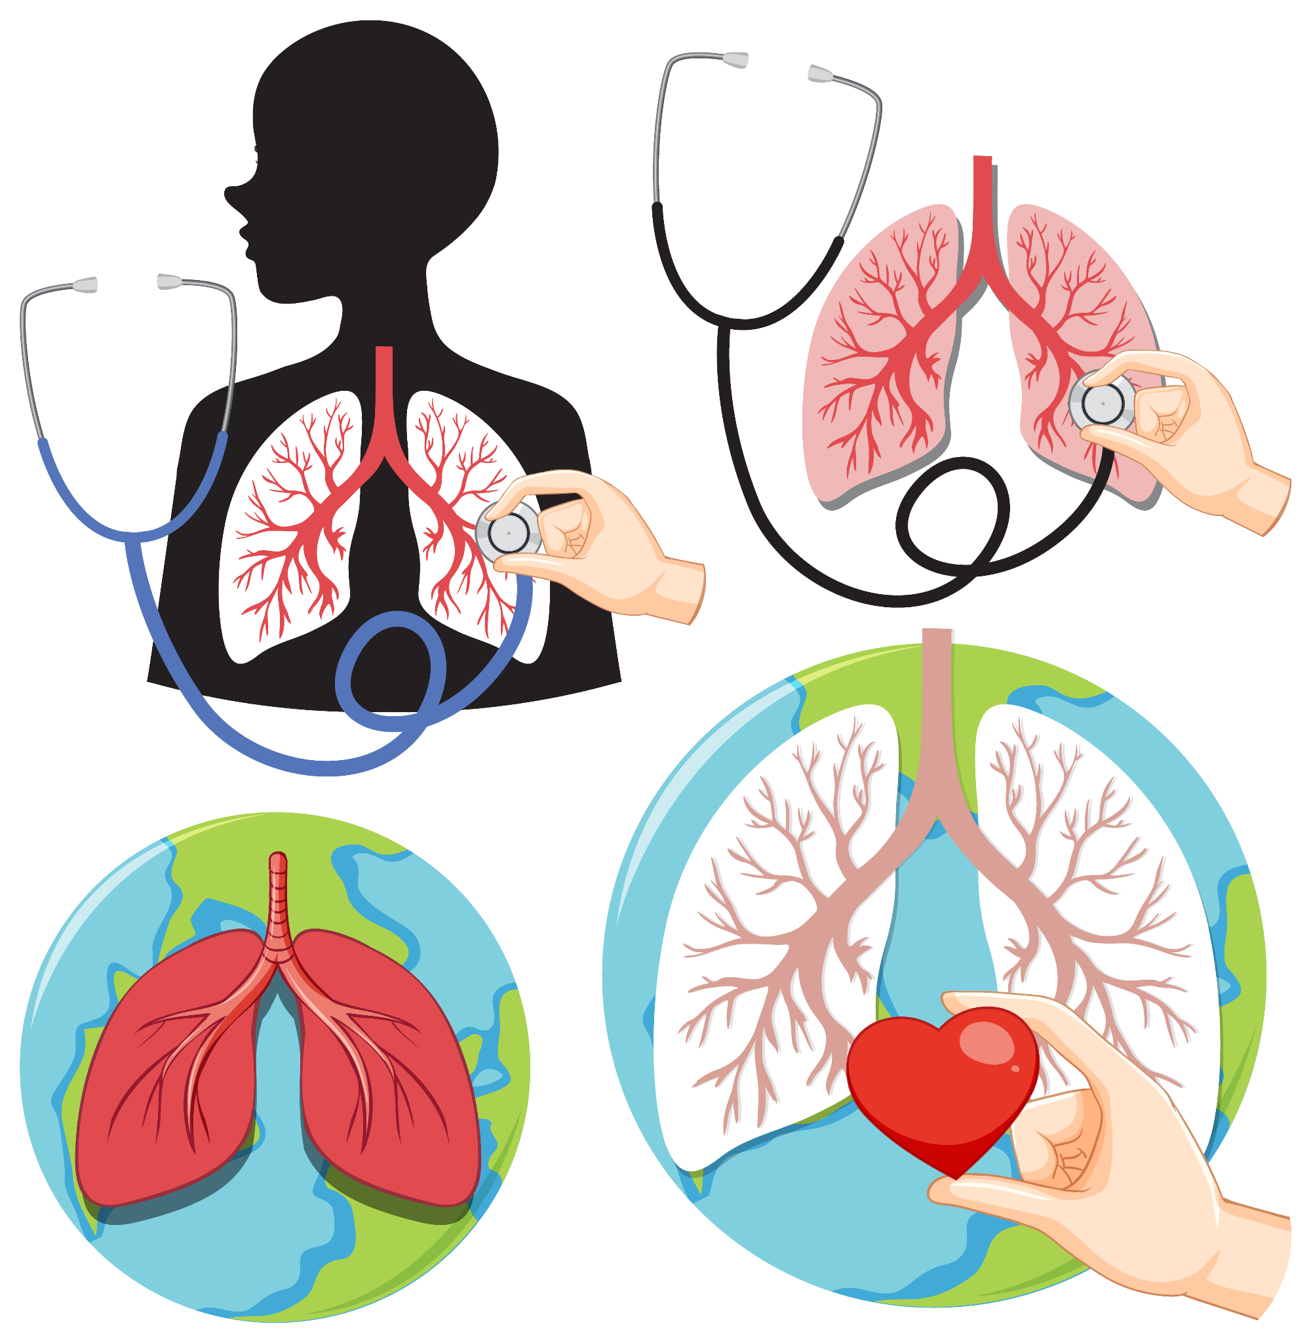
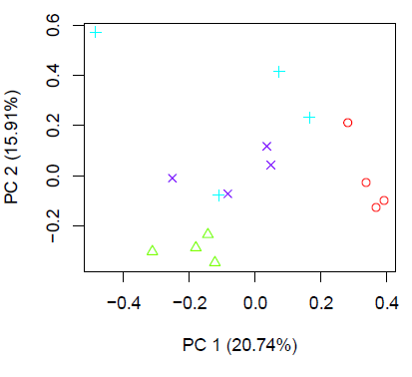
Quality control → another example
The assembling …
PCA: Correlation between samples
Metadata: Information about samples
etc…
Tissue | Treatment | Organism | Acession n | Condition | treatment
Lungs | Untreated | Homo sapiens | E-GEOD-52778 | Asthma | No stress
Lungs | Albuterol | Homo sapiens | E-GEOD-52778 | Asthma | 1μM for 18h
Lungs | Dexamethasone | Homo sapiens | E-GEOD-52778 | Asthma | 1μM for 18h
Lungs | Alb + Dex | Homo sapiens | E-GEOD-52778 | Asthma | 1μM for 18h
Untreated
Dex
Alb
Alb_Dex
https://www.frontiersin.org/articles/10.3389/fgene.2020.00011/full / https://www.ebi.ac.uk/biostudies/arrayexpress/studies/E-GEOD-52778#Protocols

Slide 13
Quality control → another example
The assembling …
PCA: Correlation between samples
Metadata: Information about samples
etc…
R1
R2
R3
R4
Untreated
Dex
Alb
Alb_Dex
Untreated
Albuterol
Dexamethasone
Alb + Dex
https://www.frontiersin.org/articles/10.3389/fgene.2020.00011/full / https://www.ebi.ac.uk/biostudies/arrayexpress/studies/E-GEOD-52778#Protocols

Slide 14

What if it there is
no Ref. Genome?

Slide 15
Functional Annotation
Translating IDs according to the tool:
Types of IDs
How it really starts:
1st level of annotation
Material for the activities Plants and Humans.
by @starline at freepik.com

Slide 16

Functional Annotation
Translating IDs according to the tool:
Types of IDs
How it really starts:
1st level of annotation
Ensembl
Ref
New
?
(for those who don’t have a reference genome)
by @starline at freepik.com

Slide 17



Activity: No ref Genome Organism
Web BLAST
GitHub course material
Get your fasta.
You need to annotate (BLAST)
Once you have your result filter
for 90-100% identity
check e-value (0.0 or close to)
Translate to Uniprot ID and name

Slide 18

Web BLAST
?
Ensembl
New
Ref
Individual analysis

Slide 19

Functional
Annotation
The basics - It starts

Slide 20
Functional Annotation
Translating IDs according to the tool:
Types of IDs
Ensembl
Ref
Material for the activities Plants and Humans.
by @starline at freepik.com

Slide 21




Functional Annotation
How to get what you need:
Uniprot ID mapping
BioMart
Programatically
Using R (e-learning or R course)
R and Python
https://www.uniprot.org/help/api_queries
https://www.uniprot.org/help/id_mapping
Translating IDs according to the tool:
Types of IDs
GenBank
RefSeq
Ensembl
Material for the activities Plants and Humans.
by @starline at freepik.com

Slide 22
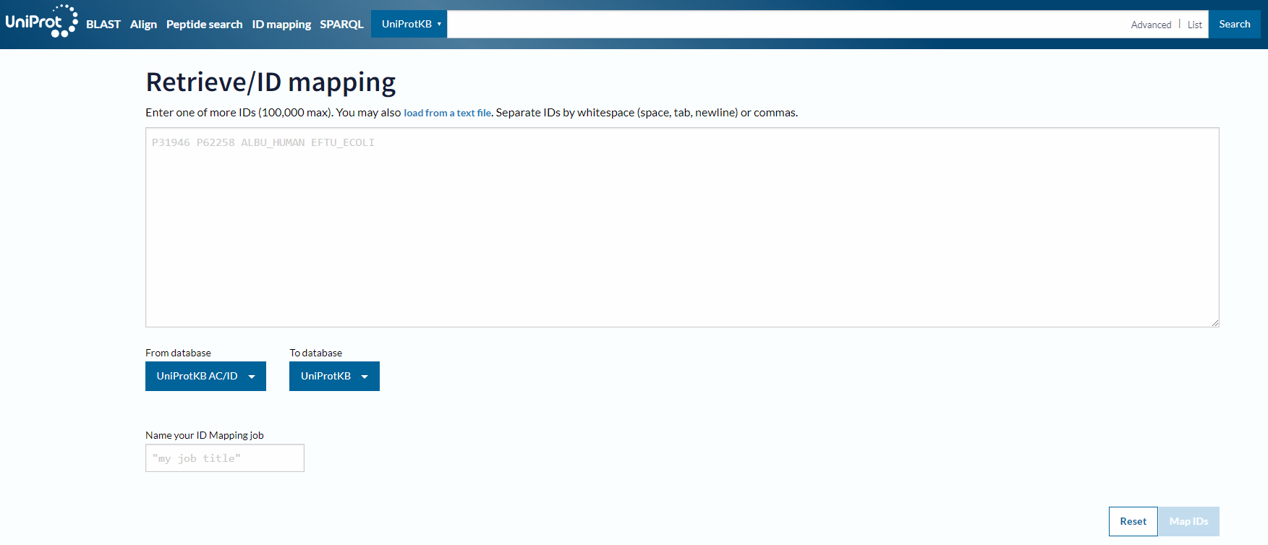
Functional Annotation

Slide 23
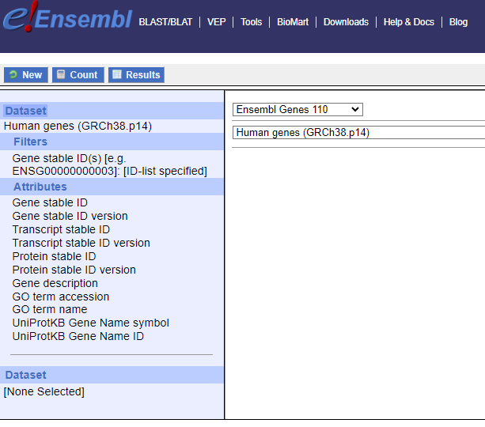
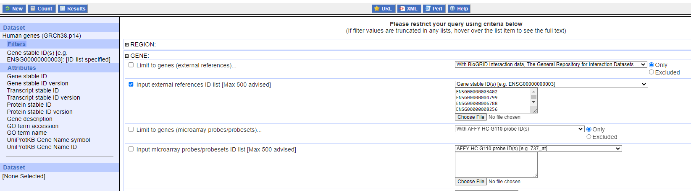
Functional Annotation

Slide 24
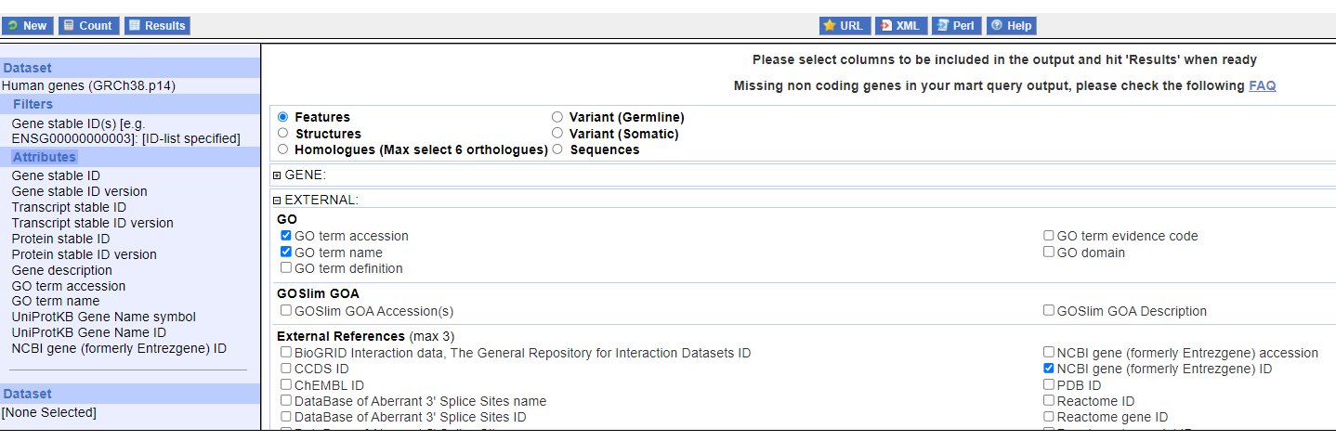
Functional Annotation

Slide 25



Activity: Mapping IDs
GitHub course material
Let's open the examples of data for
Plants and Humans.
We want to get the UniProt ID and Ensemble ID of both datasets complementary to the list you are going to find. In one example you have Uniprot names and the other Ensemble IDs.
For that we will use the id-mapping retriever resource available in Uniprot, and Biomart human id retriever and Biomart Plant id retriever available in Ensemble.

Slide 26
Enrichment Analysis

Slide 27
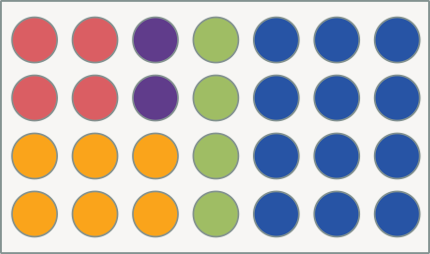
Enrichment analysis
Pull of genes
Over-represented
Image by janick
List of genes
Colors = functions
Image by janick
Notes:
It will help telling a history, instead of looking into one gene isolated.
Two directions to approach the same questions

Slide 28
Enrichment analysis
Pull of genes
Over-represented
Expression: Up or Down
List of genes
Colors = functions
Image by janick
Notes:
It will help telling a history, instead of looking into one gene isolated.
Two directions to approach the same questions

Slide 29
Enrichment analysis
Pull of genes
Over-represented
Expression: Up or Down
Two types of enrichment:
Gene ontology enrichment
Define the related terms
Gene-set enrichment
Select groups of genes
List of genes
Colors = functions
Image by janick
Notes:
It will help telling a history, instead of looking into one gene isolated.
Two directions to approach the same questions

Slide 30
Enrichment analysis
Different points of view:
Gene ontology enrichment:
All up against the Total - What terms are enriched?
Gene-set enrichment: Ranked genes, which set is + represented among most differentially expressed?
Image by janick
List of genes
Colors = functions
Image by janick

Slide 31
Enrichment analysis
Different points of view:
Gene ontology enrichment:
All up against the Total - What terms are enriched?
Gene-ontology enrichment: Which terms are more represented. Consider the relation among terms
Biological process
Molecular function
Cellular component
A
A
A
C
B
B
B
A
A
A
C
B
B
B
B
B
B
B
B
B
C
B
B
B
B
B
B
B
B
B
C
B
B
B
B
B
B
B
B
B
Image by janick
List of genes
Colors = functions
Image by janick
B
B
B
B
B
B

Slide 32

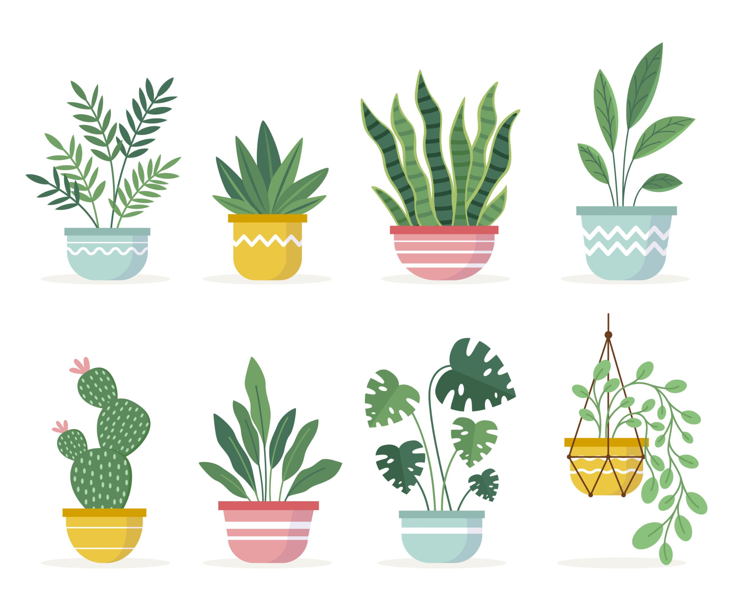
Enrichment analysis and Context
Context and scientific answers:
Specific or Nonspecific
Whole plant vs leaves
Leaves during the day vs leaves in the sunset
Whole human body vs lung sample
Health lungs vs Cancer lungs
Combination of Image by katemangostar on Freepik and Freepik image
Image by brgfx on Freepik
Notes:
It will help telling a history, instead of looking into one gene isolated.
Two directions to approach the same questions

Slide 33
Quality control enrichment analysis
Corrections for false positive cases
You need to correct False positive rates
Multiple testing
Bonferroni: More conservative Less False Positive Higher chance of False Negative
FDR Control proportion of False Positive
B&H Find highest ranking
More confidence

Slide 34
Enrichment Analysis
Gene Ontology

Slide 35
Enrichment analysis
GO enrichment
Ontology:
A set of concepts related to a domain, also used to define relationships among entities.

Slide 36
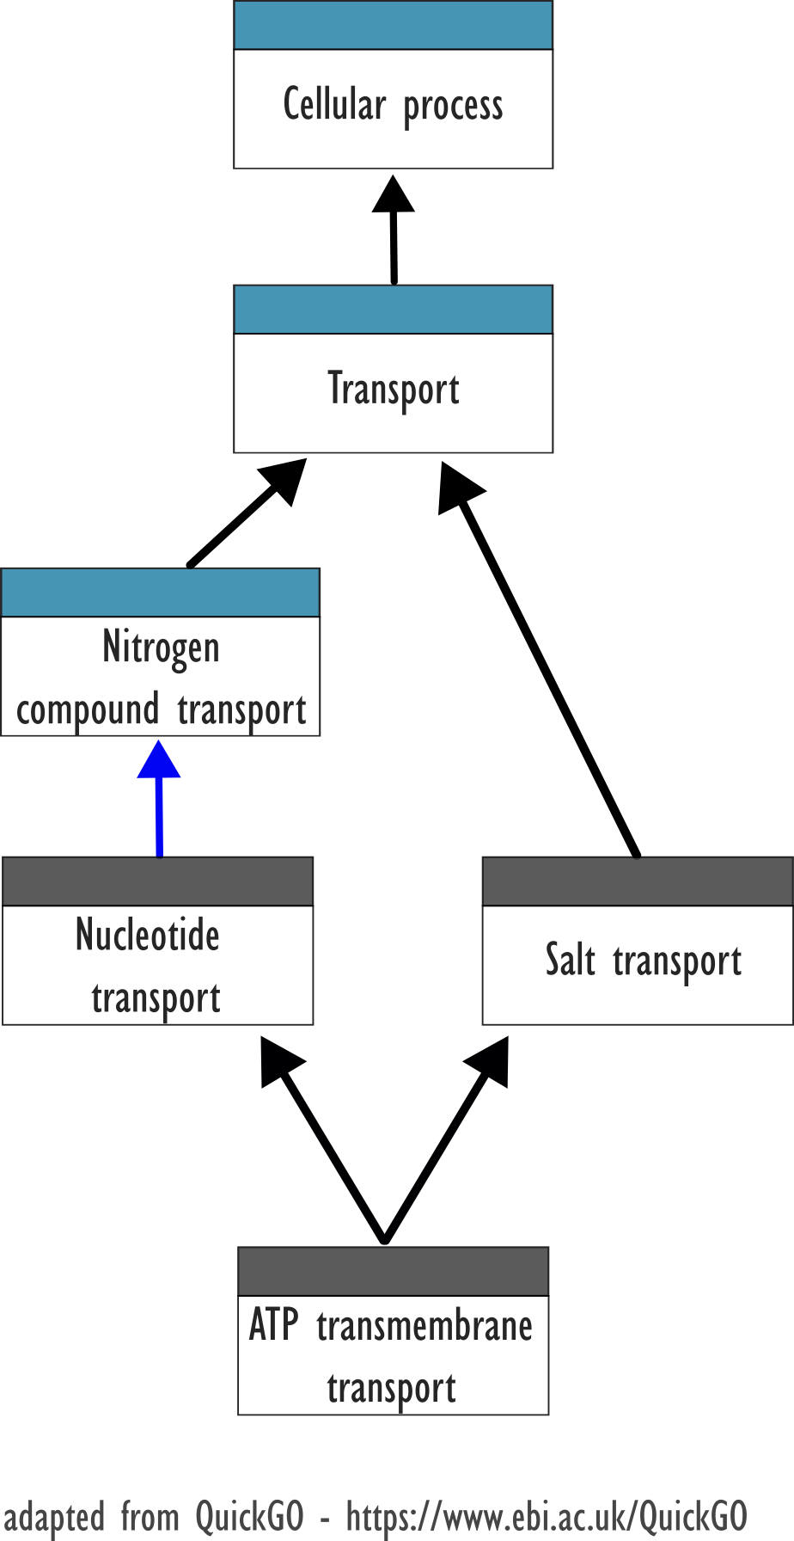
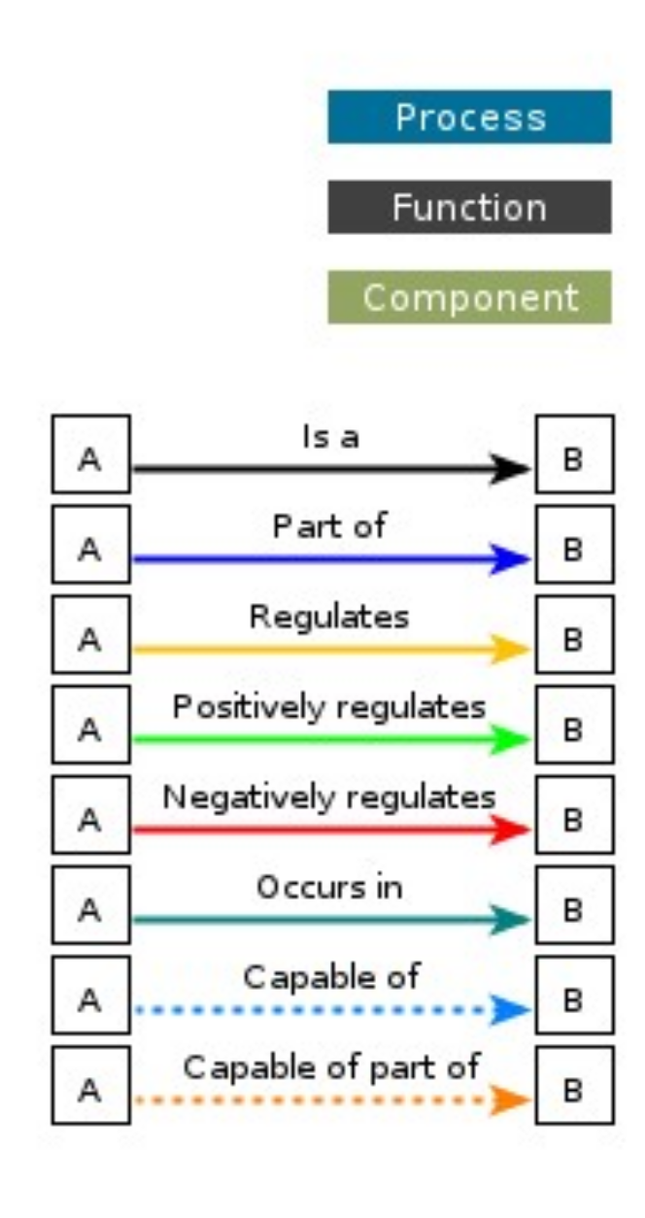
Enrichment analysis
GO enrichment
Gene Ontology:
Consortium created to provide the “state of art” about genes. The gold standard.
Molecular function: Activities
Biological process: Large process
Cellular component: Location
Ontology:
A set of concepts related to a domain, also used to define relationships among entities.

Slide 37
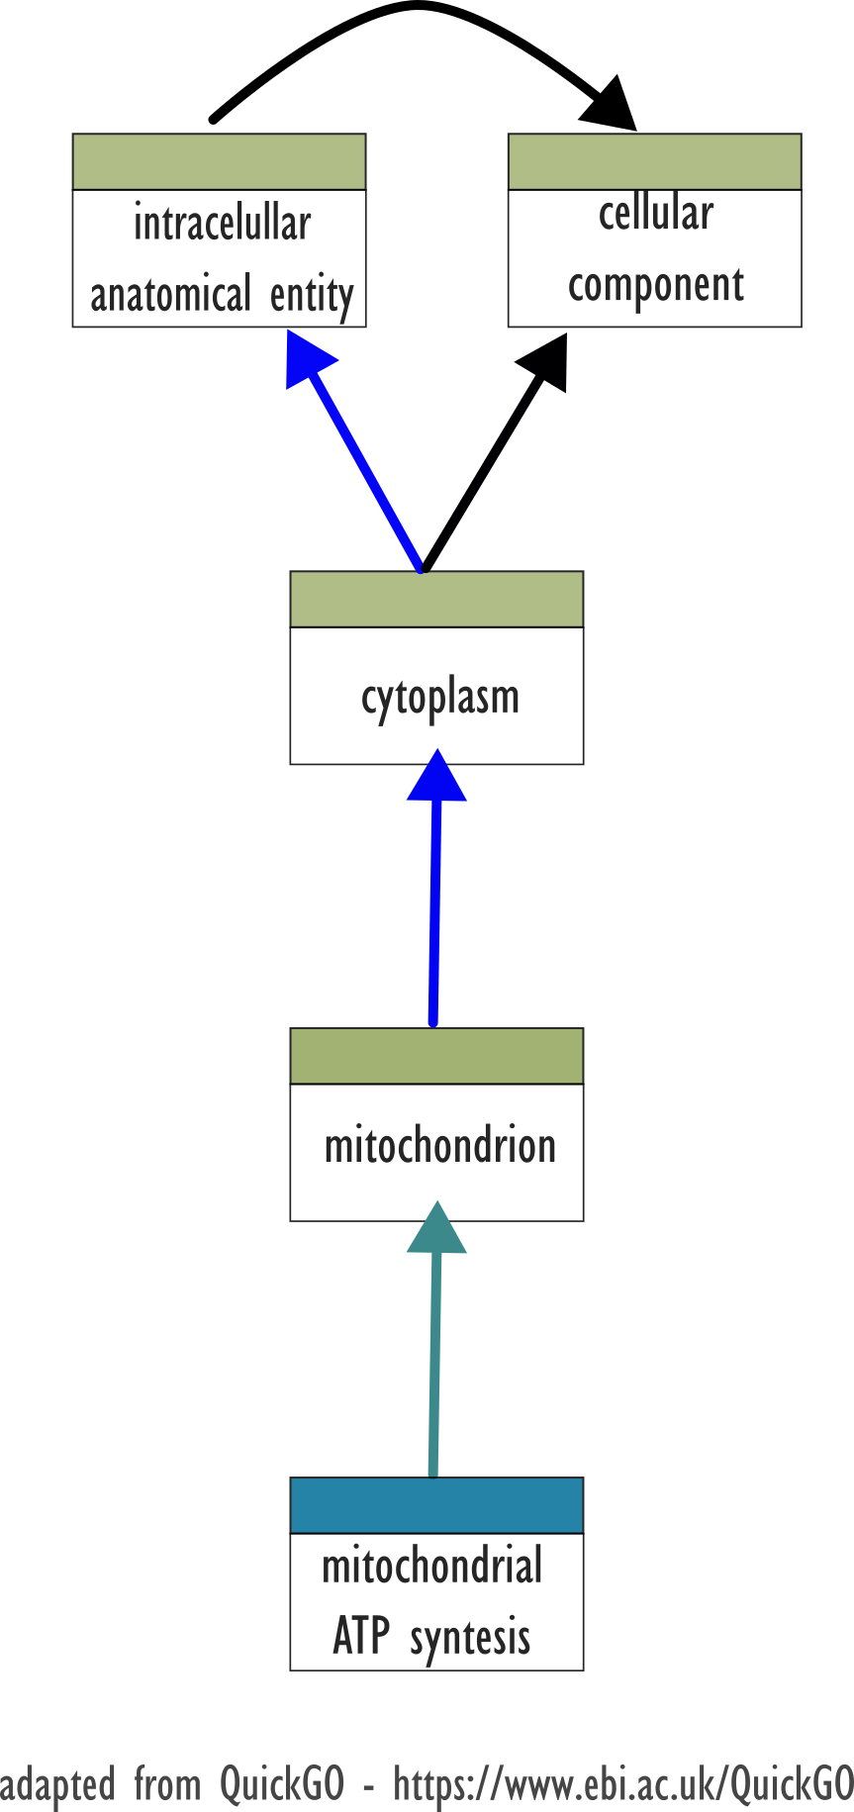
Enrichment analysis
GO enrichment
Gene Ontology:
Consortium created to provide the “state of art” about genes. The gold standard.
Molecular function: Activities
Biological process: Large process
Cellular component: Location
Ontology: A set of concepts related to a domain, also used to define relationships among entities.

Slide 38
Enrichment analysis
GO enrichment
Gene Ontology:
Consortium created to provide the “state of art” about genes. The gold standard.
Molecular function: Activities
Biological process: Large process
Cellular component: Location
Ontology: A set of concepts related to a domain, also used to define relationships among entities.
Taxon IDs:
Implicit, mostly Neutral

Slide 39

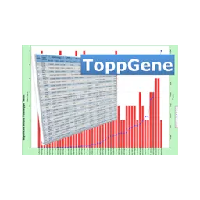




GO enrichment
A. thaliana

Slide 40

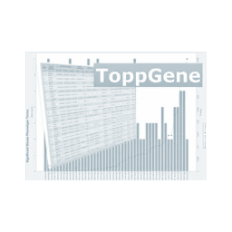









GO enrichment
A. thaliana

Slide 41

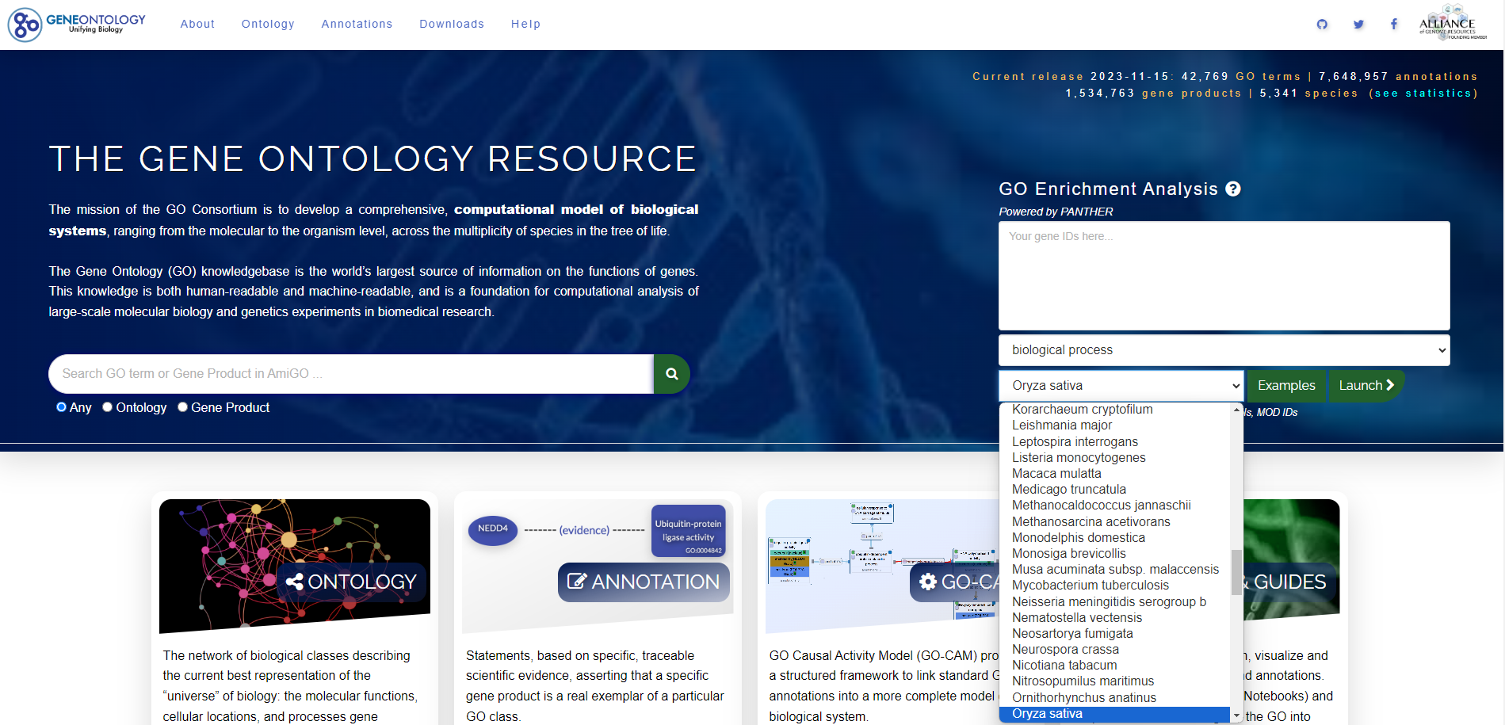
GO enrichment
Home page
Q5VRD1
A0A0P0UZP7
Q9SDD6
A2ZRY8
Q5JNT2

Slide 42
GO enrichment
Home page
Biological process
Celular function
Molecular component

Slide 43
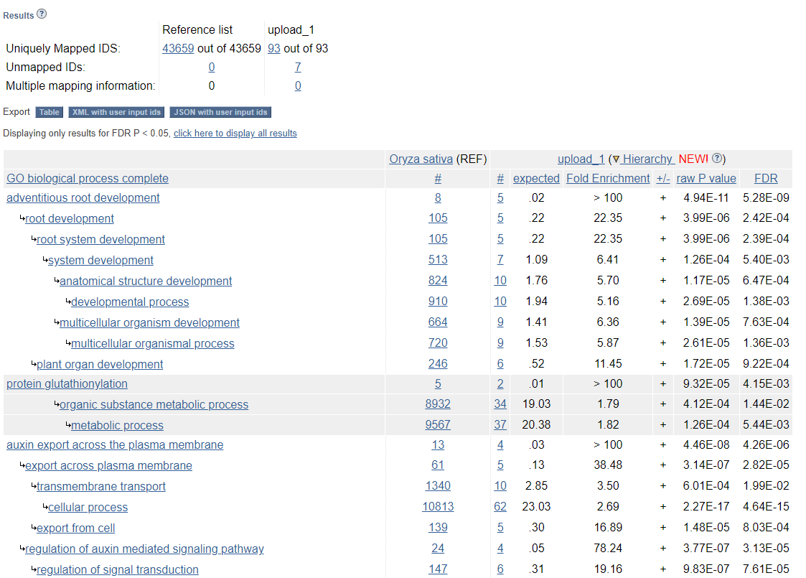
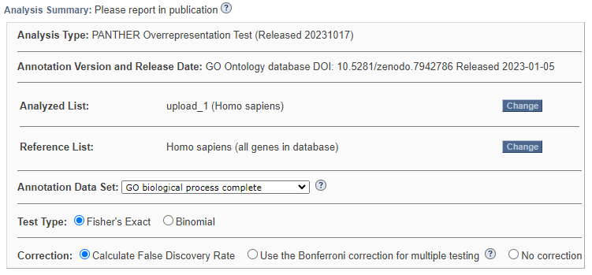

GO enrichment
Documentation

Slide 44
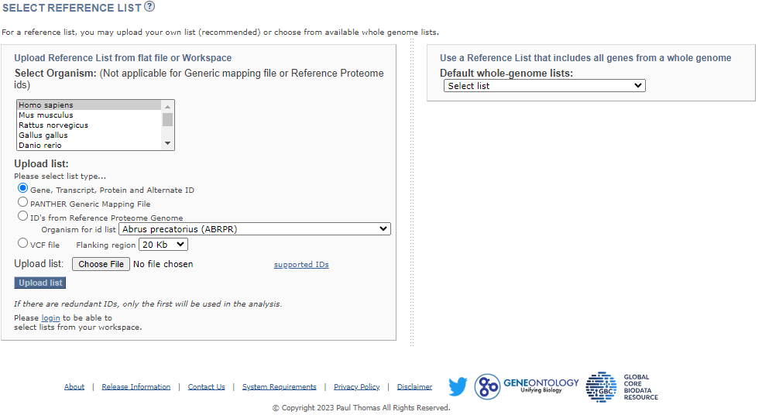
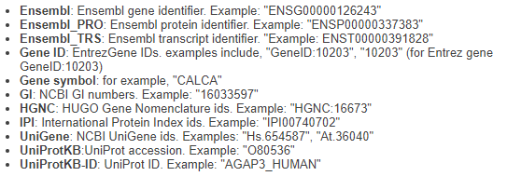
GO enrichment
Documentation

Slide 45
Activity: Mapping IDs
GitHub course material
Use the Example you’ve translated in the previous activity
Plants and Humans.
Now you want to have the GO terms annotated on Gene Ontology - Panther. Don’t forget to user your own background.

Slide 46
HOW DO YOU DEFINE THE BACKGROUND?
Context and scientific answers:
Specific or Nonspecific
Whole plant vs leaves
Leaves during the day vs leaves in the sunset
Whole human body vs lung sample
Health lungs vs Cancer lungs
Combination of Image by katemangostar on Freepik and Freepik image
Image by brgfx on Freepik

Slide 47
HOW DO YOU DEFINE THE BACKGROUND?
The whole genome?
The hole list of genes of your experiment?
Only the Up regulated genes? Or down?
What do we do with the non-differentially expressed?
Combination of Image by katemangostar on Freepik and Freepik image
Image by brgfx on Freepik

Slide 48
HOW DO YOU DEFINE THE BACKGROUND?
We use the filtered pull of genes in our experiment.
Filtered by??
Non-differentially expressed very low difference
Avoid bias (false positive)
Combination of Image by katemangostar on Freepik and Freepik image
Image by brgfx on Freepik

Slide 49
Activity: Mapping IDs
GitHub course material
Use the Example you’ve translated inthe previous activity
Plants and Humans.
Now you want to have the GO terms annotated on Gene Ontology - Panther. Don’t forget to user your own background.

Slide 50
GO enrichment
A. thaliana

Slide 51


GO enrichment
A. thaliana

Slide 52
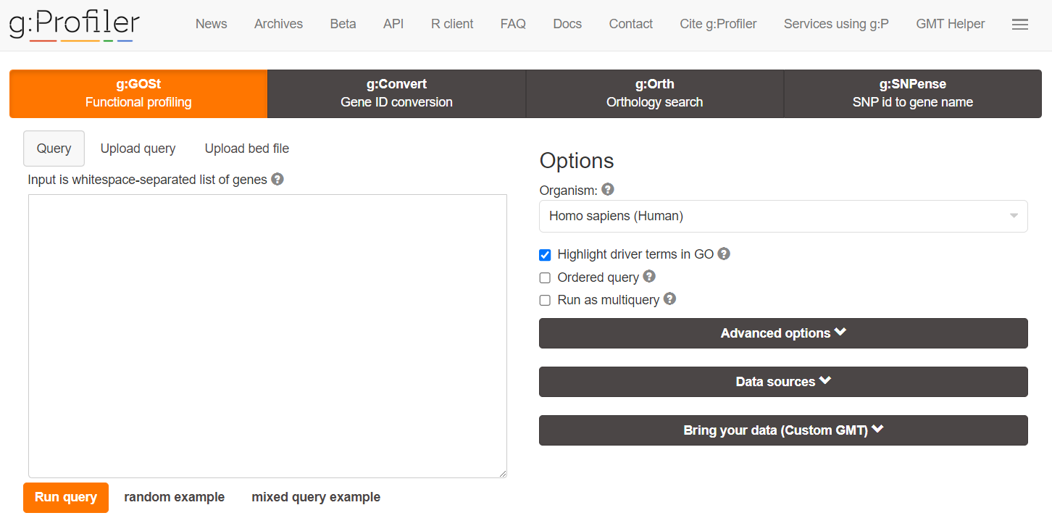
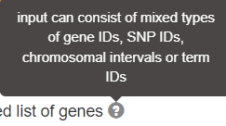
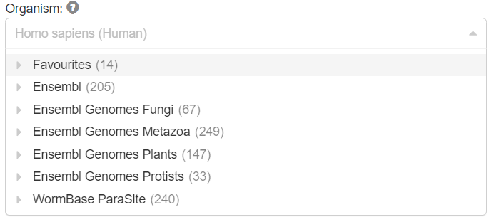
GO enrichment
Home page
Os01g0138800
Os01g0388101
Os01g0511600
Os01g0588900
Os01g0597800
Os01g0638000
Os01g0764800
Os02g0704300
Os02g0743400
Os01g0638000
Os01g0764800
Os02g0704300
Os02g0743400
Os01g0638000
Os01g0764800
Oryza sativa (rice)
ENSG00000155849
ENSG00000156675
ENSG00000157150
ENSG00000157152
ENSG00000157214
ENSG00000157510
ENSG00000157514
ENSG00000157617
ENSG00000158246
ENSG00000158716
ENSG00000158813
ENSG00000159167
ENSG00000158246
ENSG00000158716
ENSG00000158813
ENSG00000159167
ENSG00000158246

Slide 53
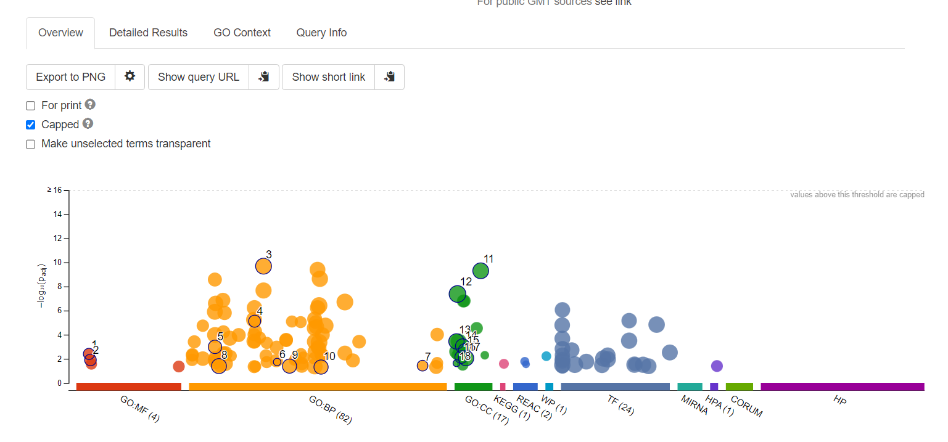
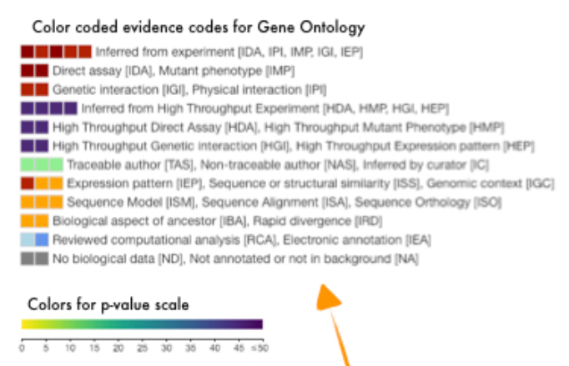
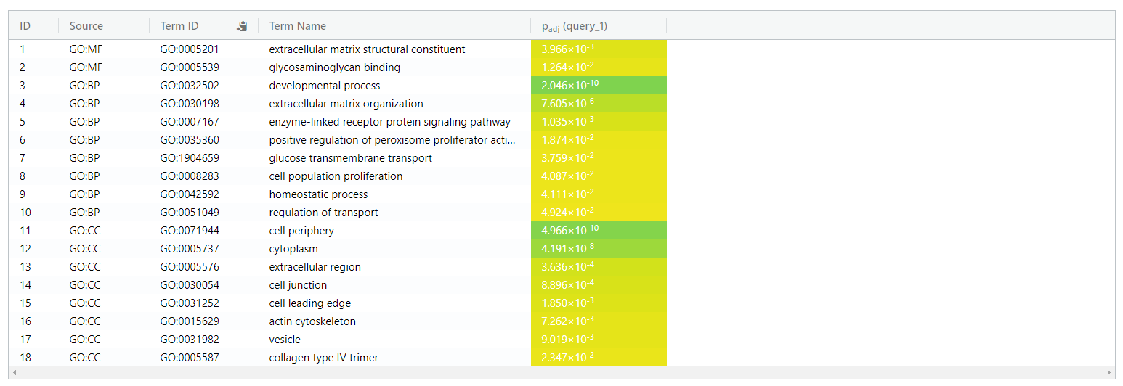
GO enrichment
Home page

Slide 54
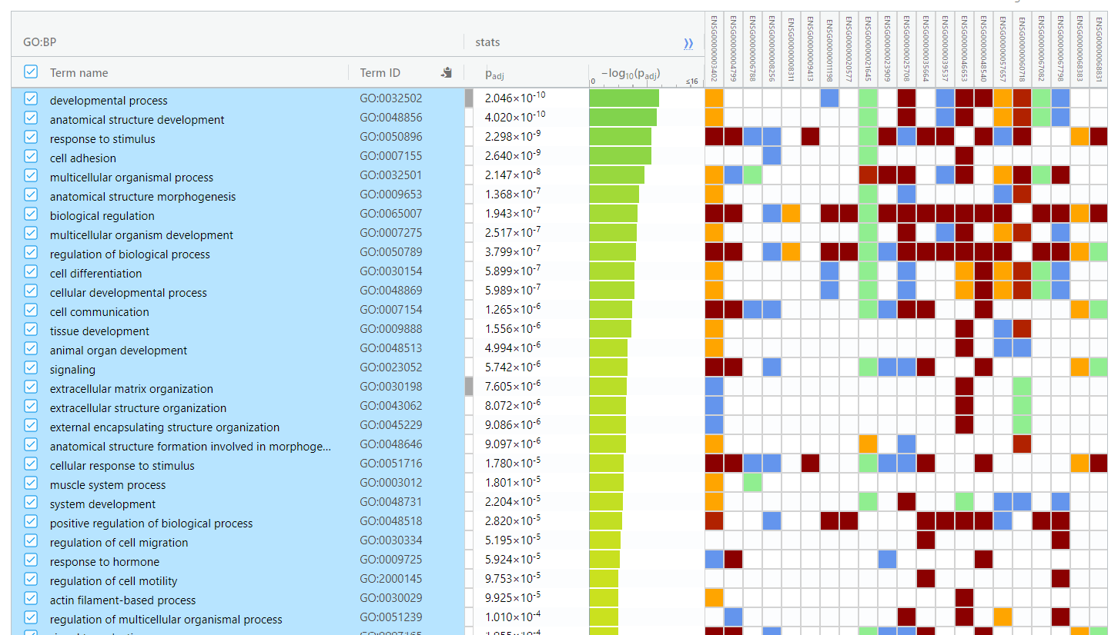
GO enrichment
Color code evidence codes for Gene Ontology
Inferred from experiment
Direct assay, Mutant phenotype
Genetic interaction, Physical interaction
Inferred from High Throughput Experiment
High Throughput Direct Assay
High Throughput Genetic interaction
Traceable Author, Non-traceable author, Inferred by curator
Expression pattern, Seq. or Structural similarity, Gen. context
Seq. model, Seq. Alignment, Seq. Orthology
Biological aspect of ancestor, Rapid divergency
Reviewed computational analysis, Electronic annotation
No biological data, Not annotated or not in background
Documentation

Slide 55
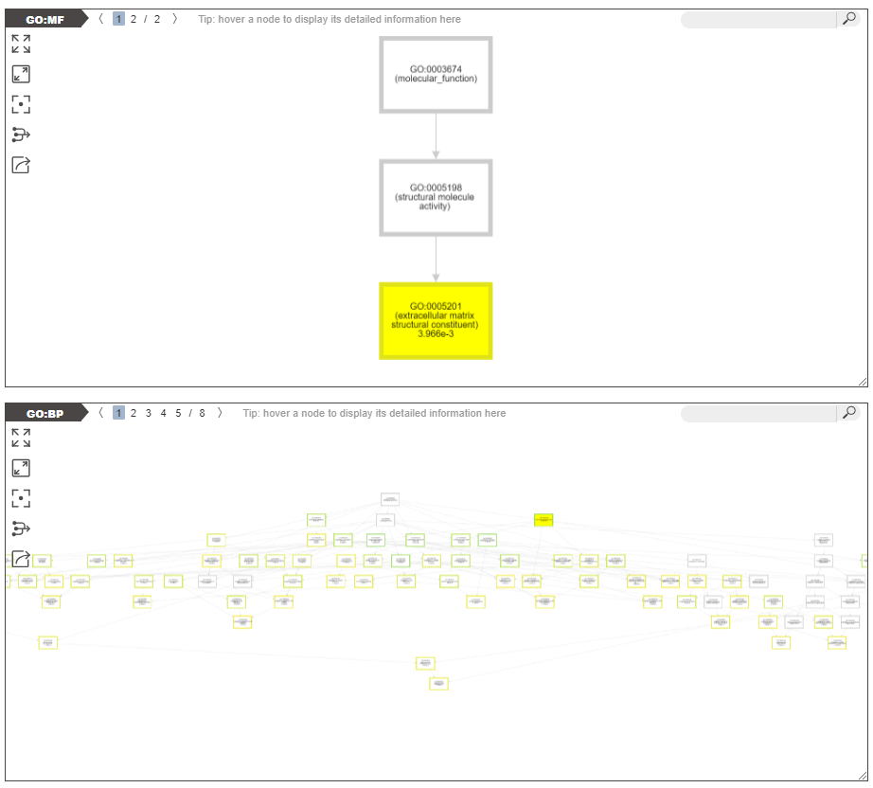

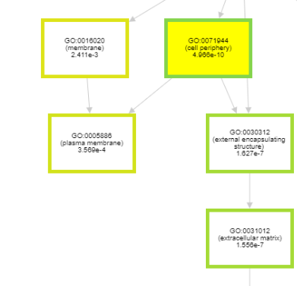
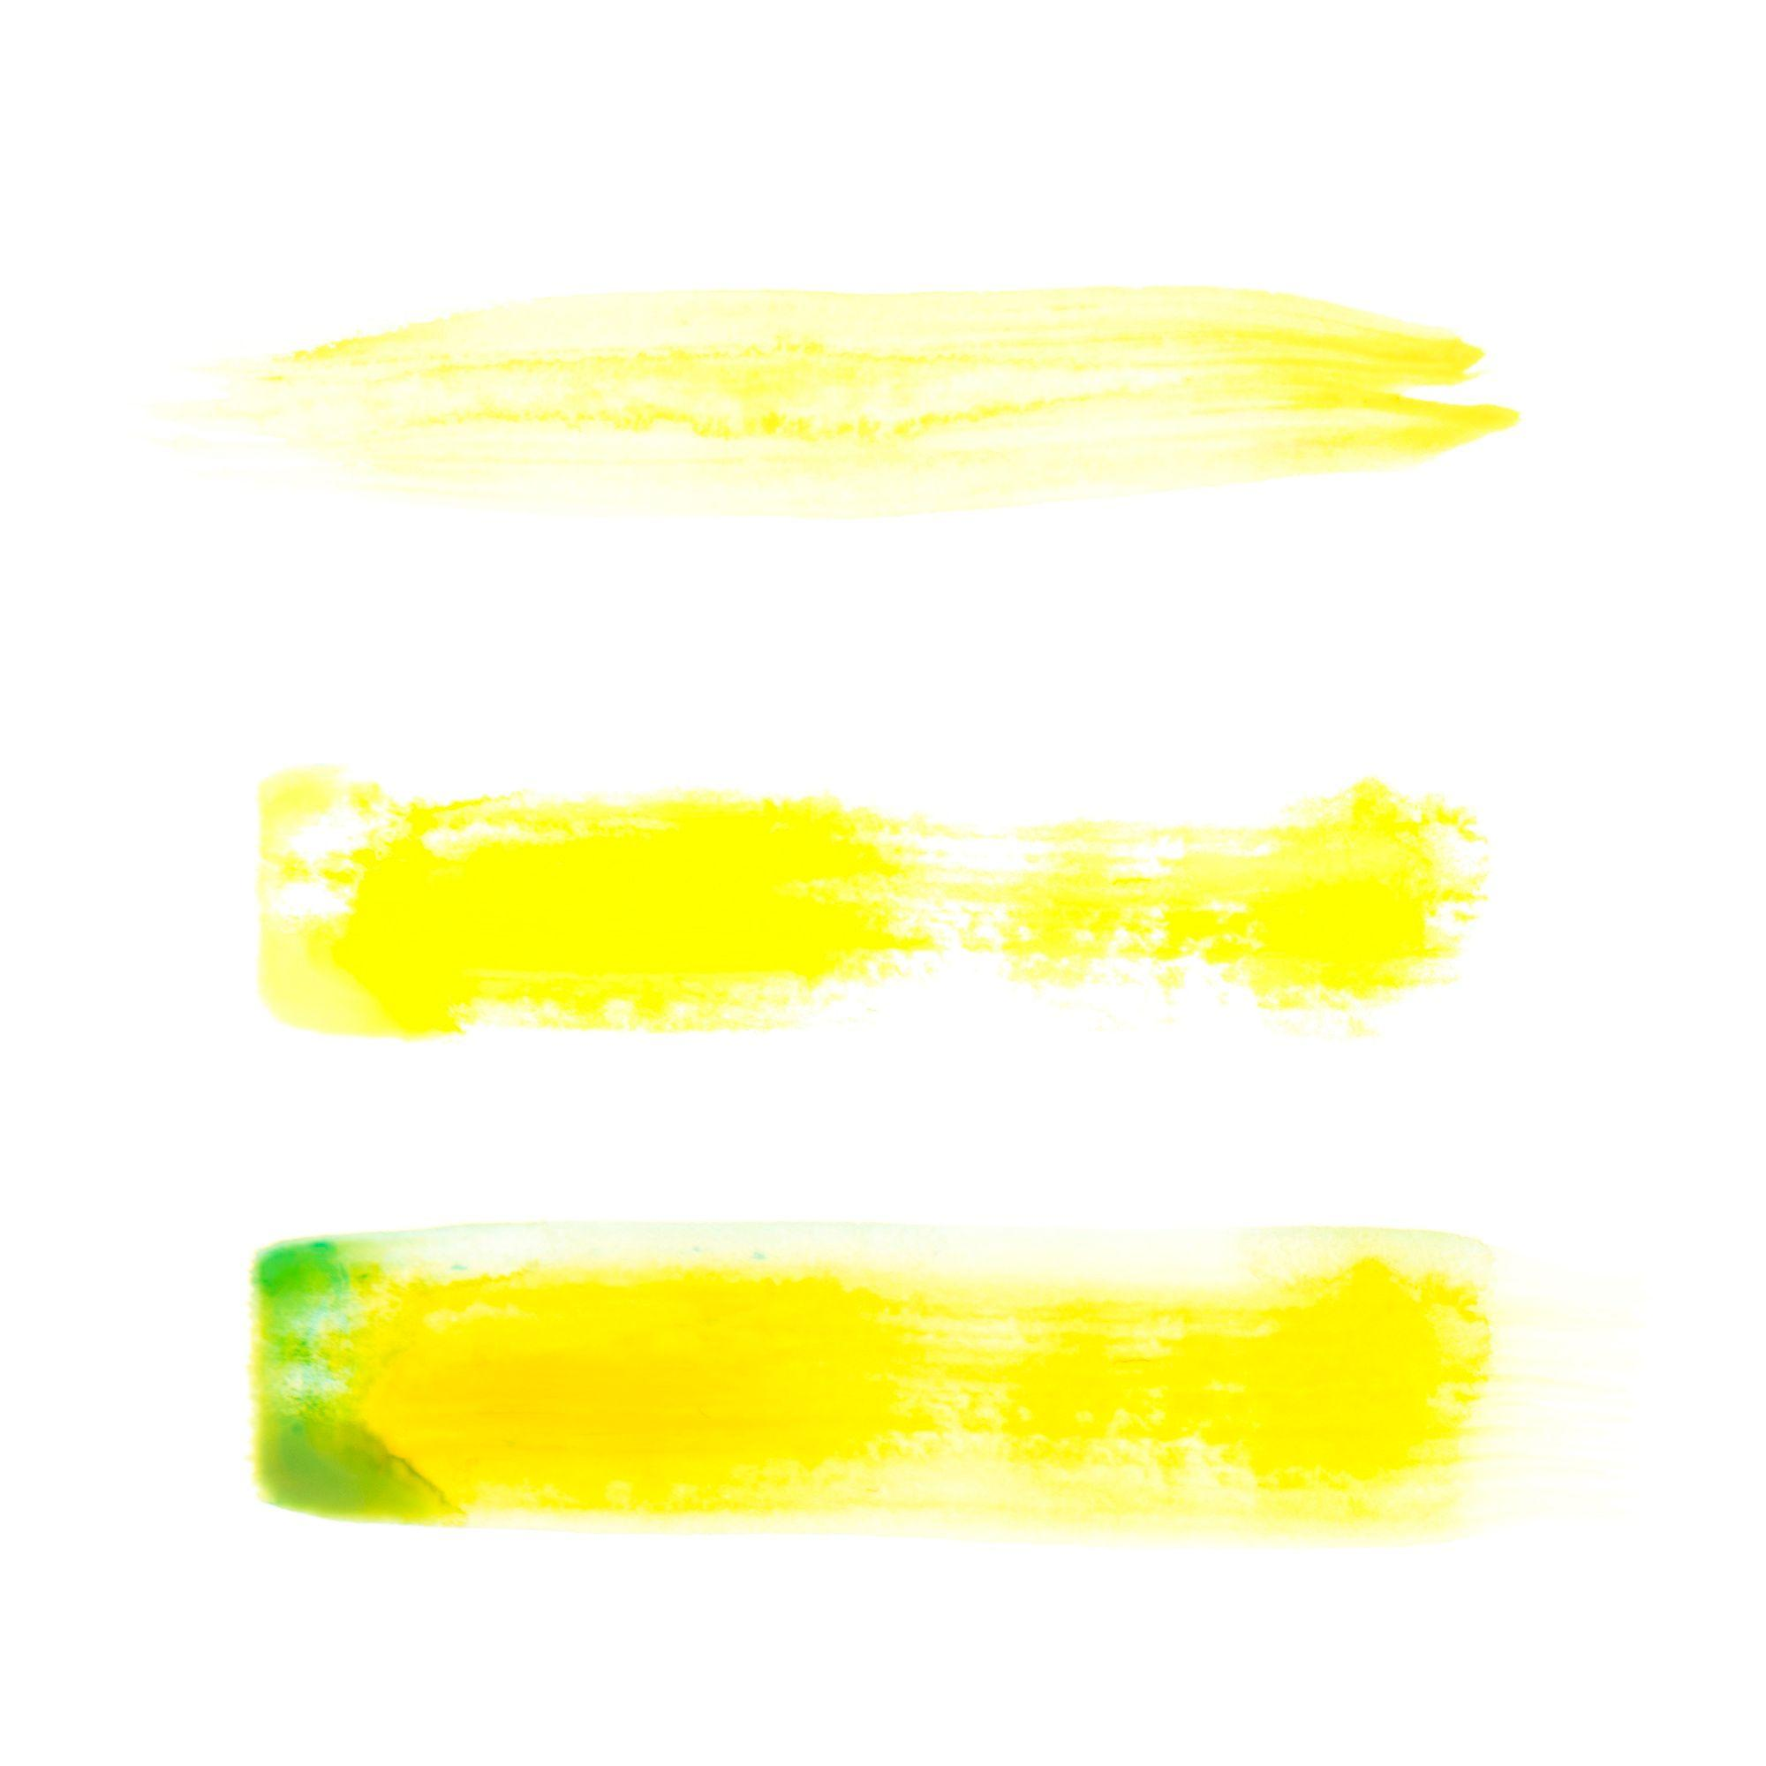
GO enrichment
Documentation
connecting the enriched terms to the root of the domain

Slide 56
Activity: Mapping IDs
GitHub course material
Use the Example you’ve translated inthe previous activity
Plants and Humans.
Now you want to have the GO terms annotated on g:profiller.

Slide 57
GO enrichment
A. thaliana

Slide 58

GO enrichment
A. thaliana

Slide 59
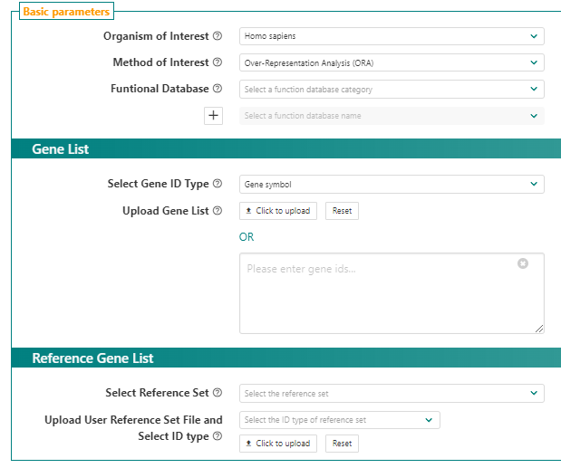
GO enrichment
*
Home page

Slide 60
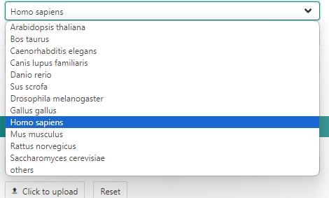
GO enrichment
*
Home page

Slide 61
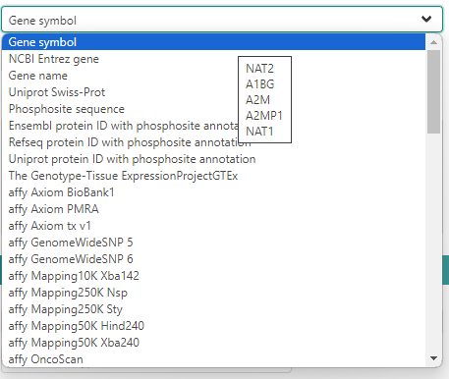
GO enrichment
*
Home page
ENSG00000003402
ENSG00000004799
ENSG00000006788
ENSG00000008256
ENSG00000008311
ENSG00000009413

Slide 62
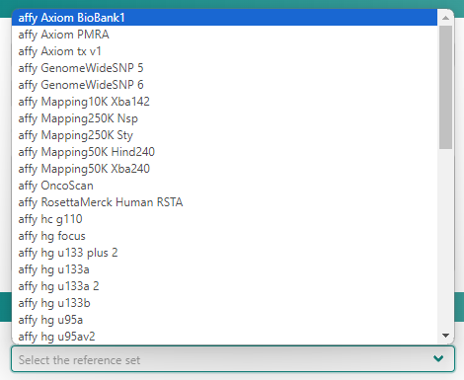
GO enrichment
*
Home page

Slide 63
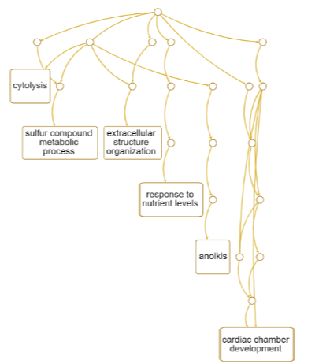
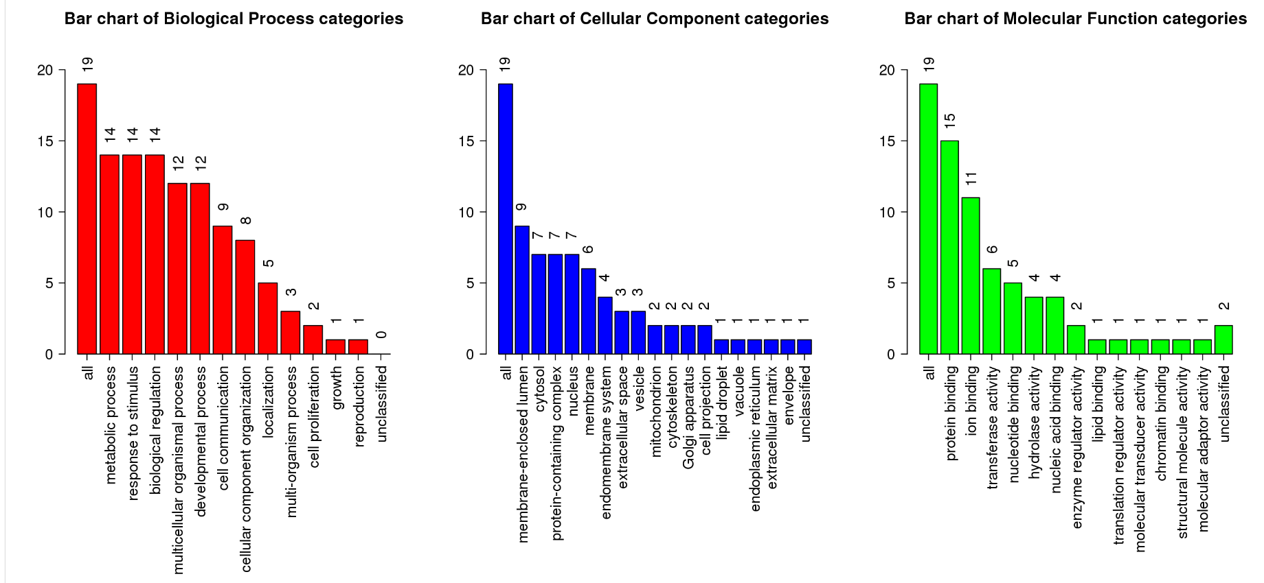
GO enrichment
*
Home page

Slide 64
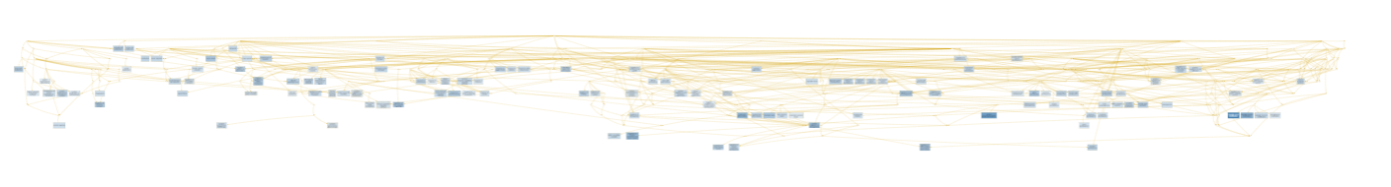
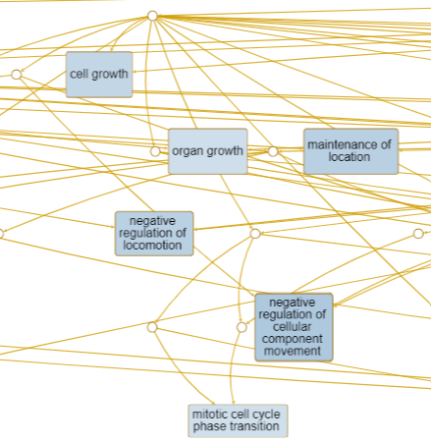
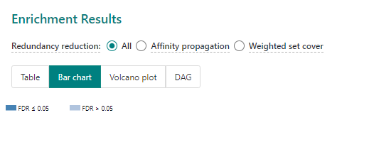
GO enrichment
*
Home page

Slide 65
Activity: Mapping IDs
GitHub course material
Use the Example you’ve translated inthe previous activity
Plants and Humans.
Now you want to have the GO terms annotated on WebGstalt.

Slide 66
GO enrichment
A. thaliana

Slide 67

GO enrichment
A. thaliana

Slide 68
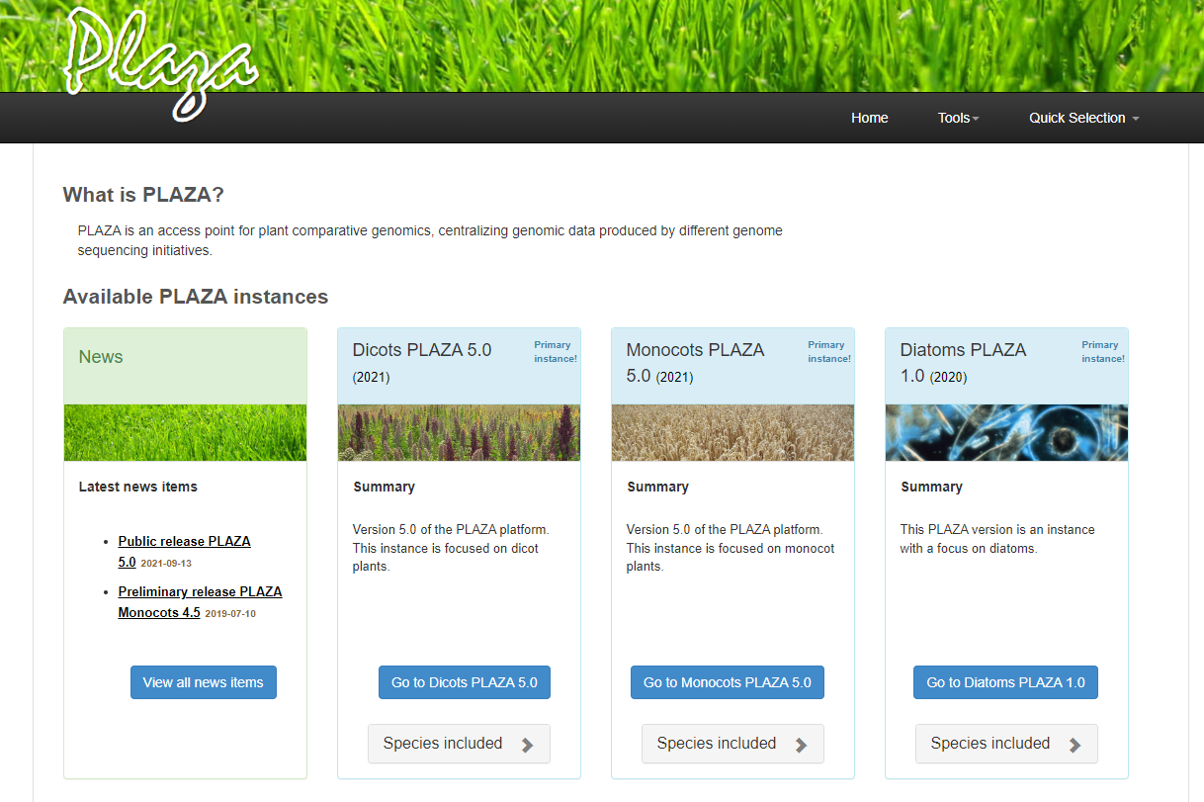
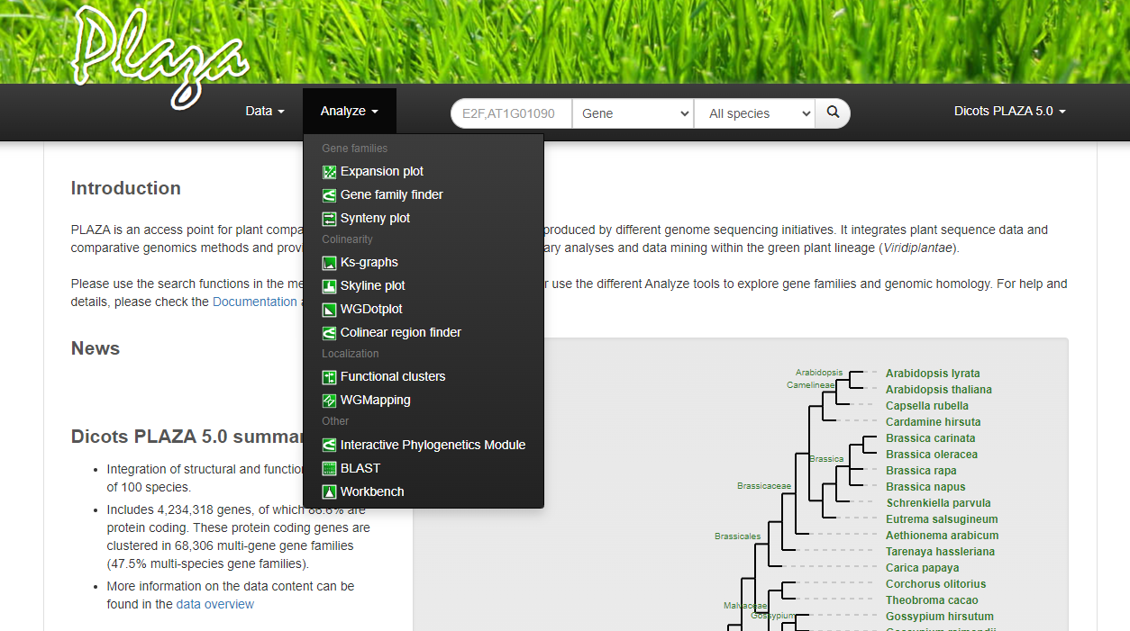
GO enrichment plants
Home page

Slide 69
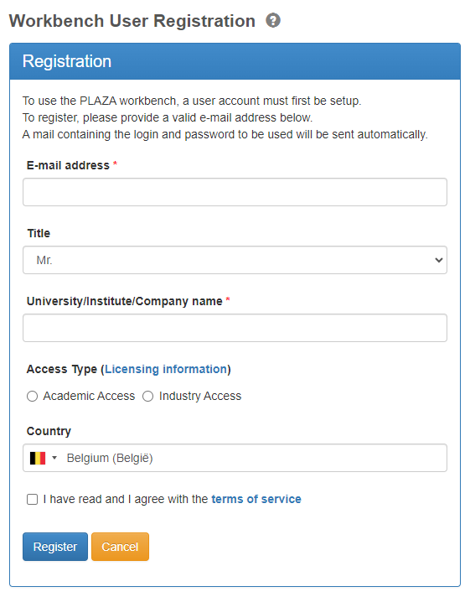
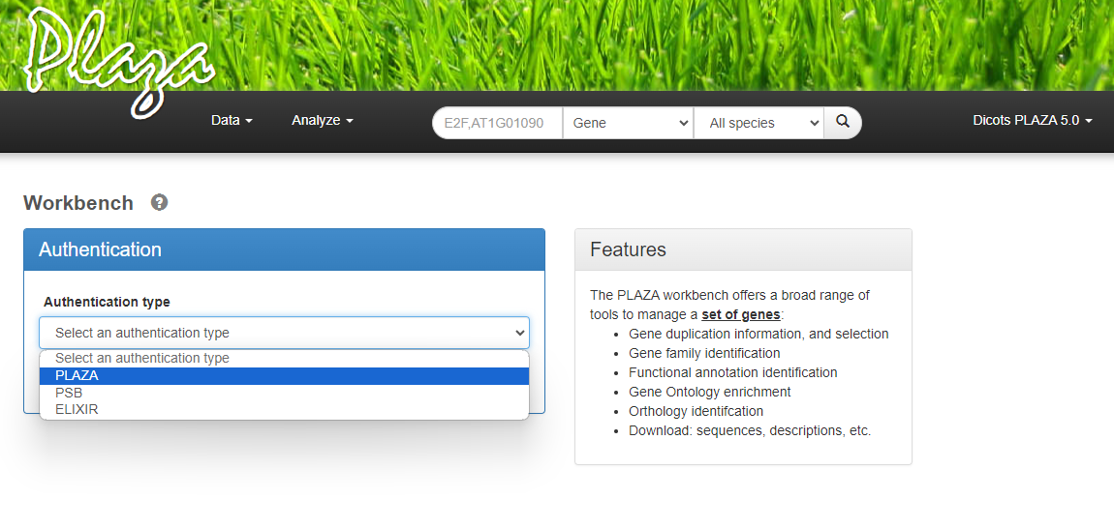
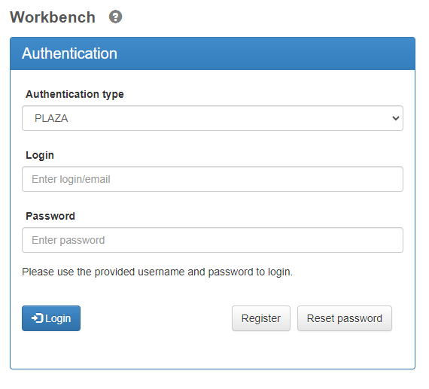
GO enrichment plants
Home page

Slide 70
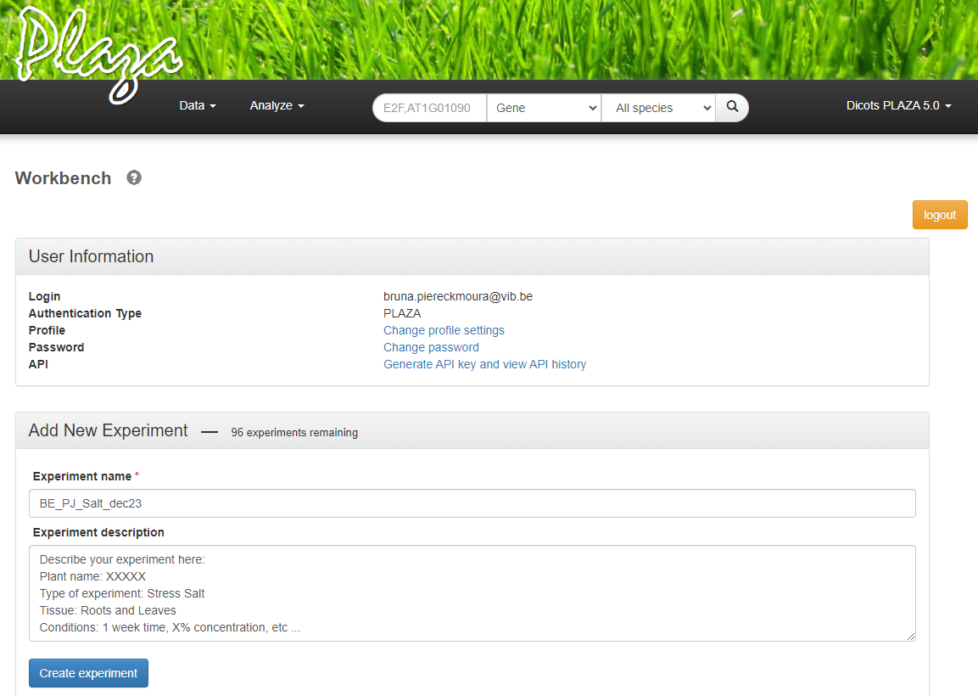
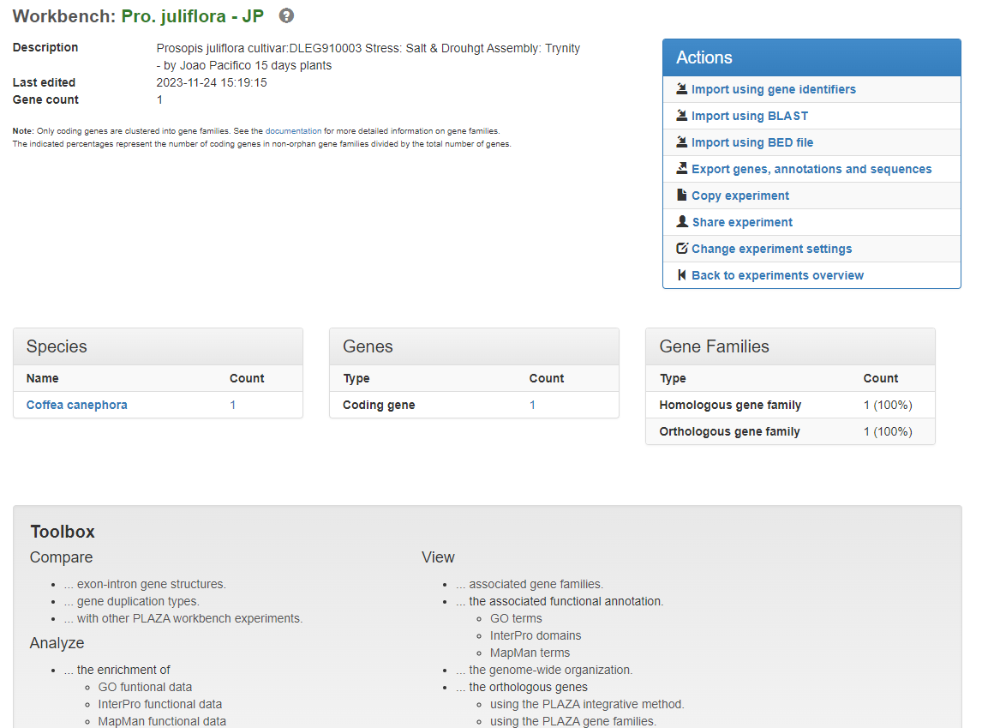
GO enrichment plants
Home page

Slide 71

GO enrichment plants
Home page

Slide 72


GO enrichment plants
Overrepresented
Underrepresented
%
Documentation

Slide 73
Activity: Mapping IDs
GitHub course material
Now if you work with plant or if you are curious to try …
Use the Example you’ve translated inthe previous activity
Plants .
Now you want to have the GO terms anotated on PLAZA.

Slide 74
GO enrichment
A. thaliana

Slide 75
GO enrichment
A. thaliana

Slide 76


GO enrichment humans
TopFun
Functional
enrichment
Home page
ENSG00000003402
ENSG00000004799
ENSG00000006788
ENSG00000008256
ENSG00000008311
ENSG00000009413
ENSG00000008256
ENSG00000008311
ENSG00000009413
ENSG00000008256
ENSG00000008311
ENSG00000009413
ENSG00000003402
ENSG00000004799
ENSG00000006788
ENSG00000008256
ENSG00000008311
ENSG00000009413

Slide 77


GO enrichment humans
Documentation

Slide 78

GO enrichment humans
Documentation

Slide 79

GO enrichment humans
Documentation

Slide 80
Activity: Mapping IDs
GitHub course material
Now if you work with Humans or mouse or if you are curious to try …
Use the Example you’ve translated inthe previous activity
Humans.
Now you want to have the GO terms annotated on ToppGene.

Slide 81

Network Analysis
Pathways and what they say

Slide 82




Network analysis
String
Home page

Slide 83



Homo sapiens
Oryza sativa

Slide 84


Home page

Slide 85


Home page

Slide 86
Activity: Network analysis plant
Home page
Now try to use the up-regulated genes of Homo sapiens or Oryza sativa visualize the topology. Filter based on confidence and highlight some functional GO annotation.
GitHub course material

Slide 87
Enrichment Analysis
Gene-Set enrichment

Slide 88


Gene Set enrichment
Mostly Differentially Expressed
1
ranking
+DE
rank
- DE
Least Differentially
Expressed
45
Bulk RNAseq func. analysis & codes
Single cell funct. analysis & codes
We choose a set of genes based on:
All genes tested for DE
Pathway annotation
We evaluate the set based on Diff expression
Sort p-value
Sort logFC
Sort normalized counts
1
45

Slide 89

Gene Set enrichment
Most DE
Least DE
+DE
rank
- DE
1
4
3
10
2
11
12
19
28
1
45

Slide 90
Gene Set enrichment
Most DE
Least DE
+DE
rank
- DE
Many are among most DE
Most probably pathway is affected
1
45

Slide 91
Most DE
Least DE
+DE
rank
- DE
31
32
33
40
41
42
34
43
1
45

Slide 92
Most DE
Least DE
+DE
rank
- DE
All are not much DE Most probably pathway is NOT affected
1
45

Slide 93
Gene Set enrichment
Most DE
Least DE
+DE
rank
- DE
5
6
14
15
24
23
1
45

Slide 94
Gene Set enrichment
Most DE
Least DE
+DE
rank
- DE
All are among most DE
Most probably pathway is affected
1
45

Slide 95
Gene Set enrichment
Most DE
Least DE
+DE
rank
- DE
4
13
20
21
22
30
29
37
Image by janick
39
38
1
45

Slide 96
Gene Set enrichment
Most DE
Least DE
+DE
rank
- DE
Genes in are spread, inconsistent answer
Most probably pathway is NOT affected
Image by janick
1
45

Slide 97
Gene Set enrichment
rank
Mostl DiffExpressed
Least DiffExpressed
Genes are spread in the rank. Some are very DE others are not.
Not affected
Genes are mostly in top of the rank.
Most are very DE.
It is affected
Genes are spread in the rank.
Some are DE others are not.
Not affected
Genes are spread in the top.
All are very DE.
It is affected
1
45

Slide 98


Gene Set enrichment Analysis
File name: file.rnk
It is a RANKED list format (tab delimited)
Number must be represented with points not comas
No headers
Manual 4 interpretations
p-value
T test

Slide 99

Gene Set enrichment Analysis
File name: file.rnk
It is a RANKED list format (tab delimited)
Number must be represented with points not comas
No headers
p-value
T test

Slide 100



Supplementary video about graph interpretation
Enrichment Score
Notes:
https://www.youtube.com/watch?v=Yi4d7JIlAsM
How to interpret GSEA results and plot - simple explanation of ES, NES, leading edge and more!
By Biostatsquid

Slide 101


Slide 102
Activity: Gene-set enrichement
Home page
Get your experiment Expression and check for Gene enrichment using WebGestalt.
Or use the examples for
Plant and Human.
GitHub course material

Slide 103

Activity:
GitHub course material
Use the list of genes in the EXAMPLE dataset and make the Enrichment analysis (GO annotation) using at least 3 of the introduced tools. (Create a folder for your project so you can save the results of the 3 analysis.)
COMPARE them, are the results consistent?
(Run individually and discuss observations with your college (2 to 3 people))
Get a set of interesting proteins and check the topology in STRING.
At last, check for gene-set enrichment using WebGestalt.
g:profiler
GeneOntology
String
ToppGene
WebGestalt
Plaza

